Slide 1



Are Journalists opinions influenced by short sale data?
A news sentiment analysis approach
Final Project Presentation
Opencampus: Machine Learning with TensorFlow
Robert Hennings
27.06.2023

Slide 2
Agenda
Project Description
Project Conditions
Project Steps
Data Research
Data Aggregation
Data Cleaning/Formatting
Data Selection
Data/ Feature Engineering
Model Setup: NLP Classification
Model Training
Model Optimization
Inference, Statistics and Robustness Tests

Slide 3
Agenda
Project Scope – To Dos
Project Structure
Final Results and Models overview/ comparison
Project References

Slide 4


I. Project Description
Bildquelle:
https://www.google.com/url?sa=i&url=https%3A%2F%2Fme2be.de%2Fhochschulen%2Fcau-christian-albrechts-universitaet-zu-kiel%2F&psig=AOvVaw3pyzL9cEIYeIjpIqHRPR5F&ust=1667135603618000&source=images&cd=vfe&ved=0CAoQjRxqFwoTCKDeyqLChfsCFQAAAAAdAAAAABAM

Slide 5
I. Project Description
Main Research Question: Based on publicly published short interest data, can one infere if and if, how strong jounalists opionion is influenced by it regarding the company coverage?
What consequences does this have for the considered listed companies? (In terms of rate or return and/or associated risk?)
Increased Short Sale Quota
Expected Future Decline of Stock Price
Alert for Journalists
Bad Publicity
Negative News Sentiment

Slide 6
I. Project Description
Main Research Question: Based on publicly published short interest data, can one infere if and if, how strong jounalists opionion is influenced by it regarding the company coverage?
What consequences does this have for the considered listed companies? (In terms of rate or return and/or associated risk?)
Decreased Short Sale Quota
Expected Future Rise of Stock Price
Alert for Journalists
Good Publicity
Positive News Sentiment

Slide 7
I. Project Description
Increased Short Sale Quota
Neutral News Sentiment
Expected Future Decline of Stock Price
Balanced Level / Equilibrium
Alert for Journalists
Rising stock price
Bad Publicity
Markets incorporate the News
Negative News Sentiment
The Capital Markets identify and incorporate News in their assesment of the current stock price
Positive News Sentiment
Markets incorporate the News
Good Publicity
Declining stock price
Alert for Journalists
Balanced Level / Equilibrium
Potential Overreaction
Decreased Short Sale Quota
Neutral News Sentiment

Slide 8
III. Project Steps
Bildquelle:
https://www.google.com/url?sa=i&url=https%3A%2F%2Fme2be.de%2Fhochschulen%2Fcau-christian-albrechts-universitaet-zu-kiel%2F&psig=AOvVaw3pyzL9cEIYeIjpIqHRPR5F&ust=1667135603618000&source=images&cd=vfe&ved=0CAoQjRxqFwoTCKDeyqLChfsCFQAAAAAdAAAAABAM

Slide 9
III. Project Steps
Data Research
Data Aggregation
Data Cleaning/Formatting
Data Selection
Model training
Model setup: NLP Classification
Data/Feature Engineering
Model optimization
Inference, Statistics and Robustness Tests
Test ChatGPT against Model

Slide 10
III. Project Steps
Data
Model Phase
Own Model
Labeled Sentiment Data
News Article Data
Short Volume Data
Pretrained Models

Slide 11
III. Project Steps
Data Research
Bildquelle:
https://www.google.com/url?sa=i&url=https%3A%2F%2Fme2be.de%2Fhochschulen%2Fcau-christian-albrechts-universitaet-zu-kiel%2F&psig=AOvVaw3pyzL9cEIYeIjpIqHRPR5F&ust=1667135603618000&source=images&cd=vfe&ved=0CAoQjRxqFwoTCKDeyqLChfsCFQAAAAAdAAAAABAM

Slide 12
III. Project Steps
Data Research
Data Aggregation
Data Cleaning/Formatting
Data Selection
Model training
Model setup: NLP Classification
Data/Feature Engineering
Model optimization
Inference, Statistics and Robustness Tests

Slide 13
Data Research
III. Project Steps
NLP Classification
Develop the whole model on our own
Use a pretrained model and optimize it
Need of labeled dataset
No need of labeled dataset
Categorical labels (good, neutral, bad)
Numerical labels (good: 70-100, neutral: 40-60, bad: 0-40)
Tweak Model output to satisfy the needed numerical scale

Slide 14
Data Research
III. Project Steps
NLP Classification
Develop the whole model on our own
Use a pretrained model and optimize it
Need of labeled dataset
No need of labeled dataset
Short Sale Data
Long history of stock specific time series
News Data
Full news article body
Long history of news articles in multiple languages
Numerical Labels for classification

Slide 15
III. Project Steps
Data Research
-
Labeled Sentiment Data
Bildquelle:
https://www.google.com/url?sa=i&url=https%3A%2F%2Fme2be.de%2Fhochschulen%2Fcau-christian-albrechts-universitaet-zu-kiel%2F&psig=AOvVaw3pyzL9cEIYeIjpIqHRPR5F&ust=1667135603618000&source=images&cd=vfe&ved=0CAoQjRxqFwoTCKDeyqLChfsCFQAAAAAdAAAAABAM

Slide 16
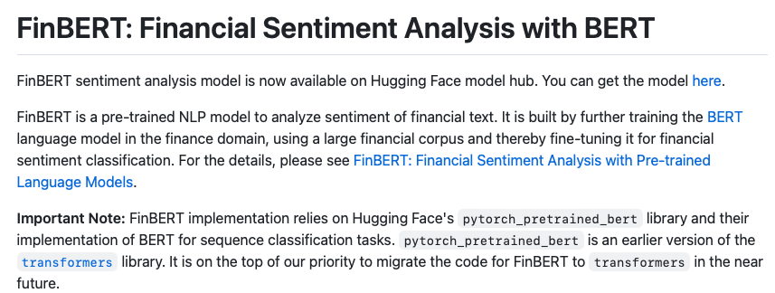
Data Research
III. Project Steps
Sentiment Data
FinBERT

Slide 17
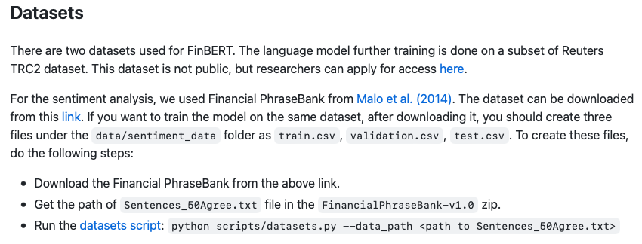
Data Research
III. Project Steps
Sentiment Data
FinBERT

Slide 18
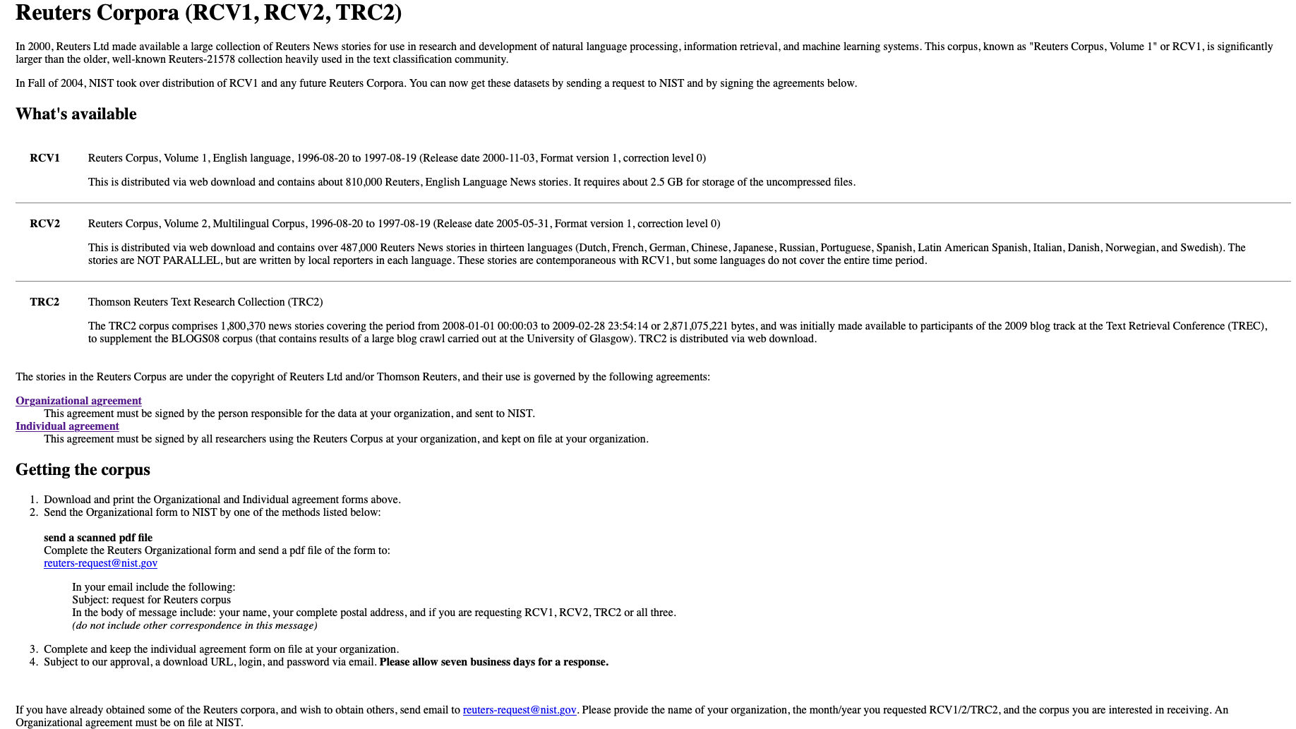
Data Research
III. Project Steps
Sentiment Data
Reuters Data Set

Slide 19
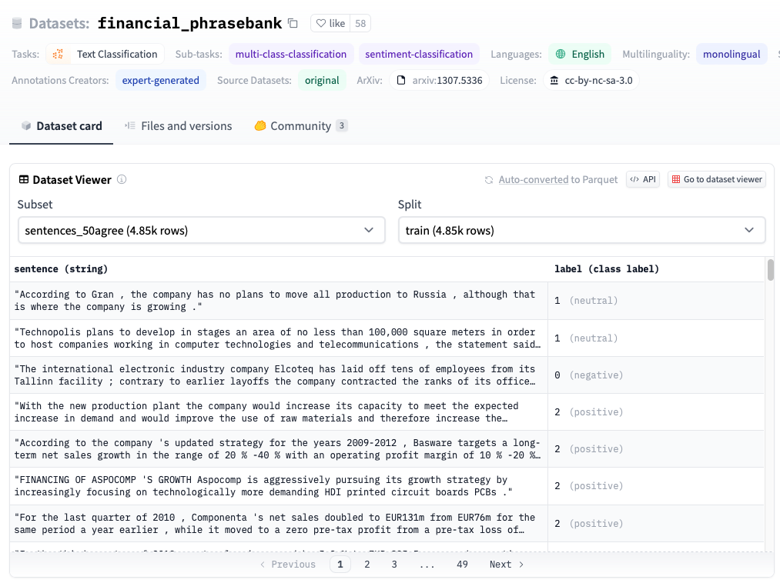
Data Research
III. Project Steps
Sentiment Data
FinPhrase Data Set
Categories
2: Positive
1: Neutral
0: Negative

Slide 20
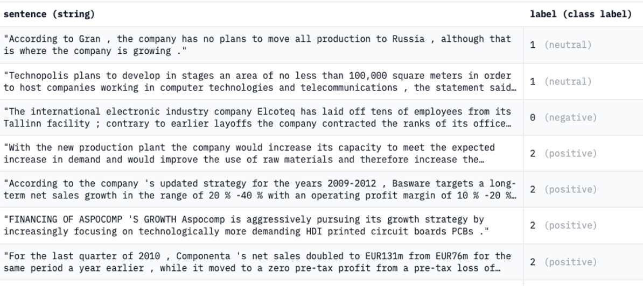
Data Research
III. Project Steps
Sentiment Data
FinPhrase Data Set

Slide 21

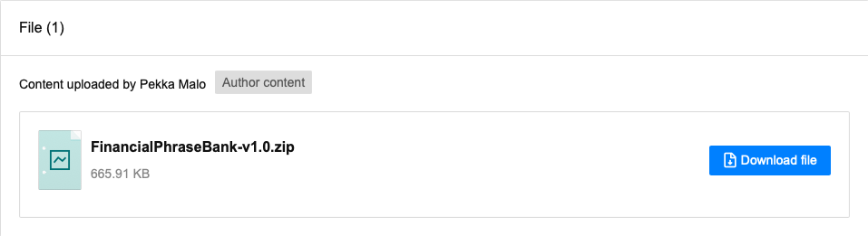
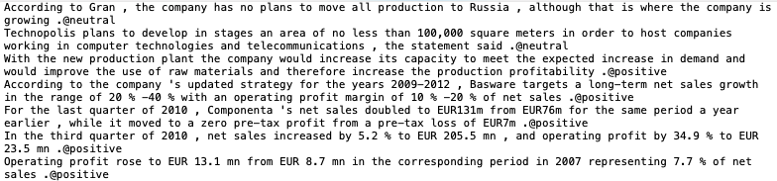

Data Research
III. Project Steps
Sentiment Data
FinPhrase Data Set

Slide 22
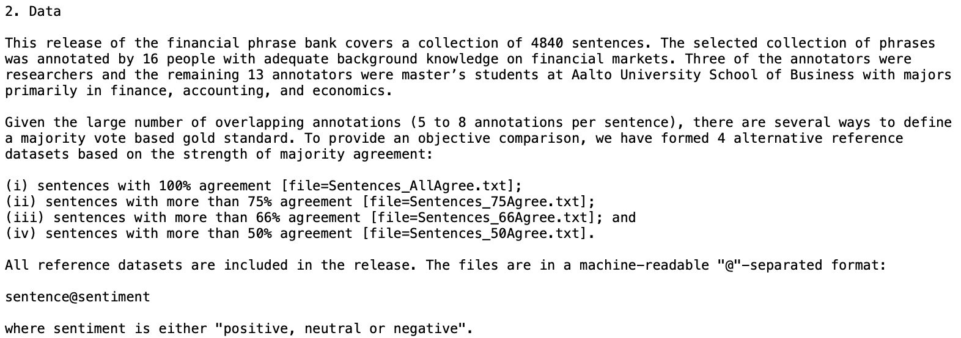
Data Research
III. Project Steps
Sentiment Data
FinPhrase Data Set

Slide 23
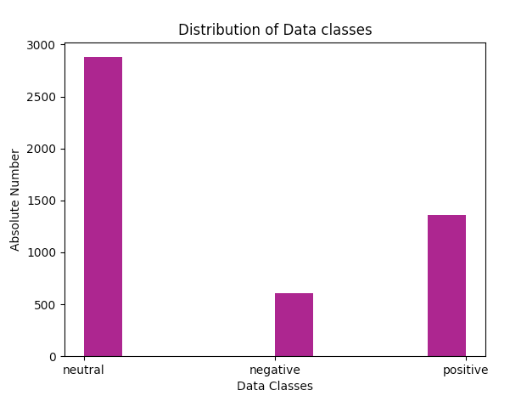
Data Research
III. Project Steps
Sentiment Data
FinPhrase Data Set
Categories
Positive: 1363 (28,1%)
Neutral: 2879 (59,4%)
Negative: 604 (12,5%)
Total: 4846
Heavily Imbalanced

Slide 24
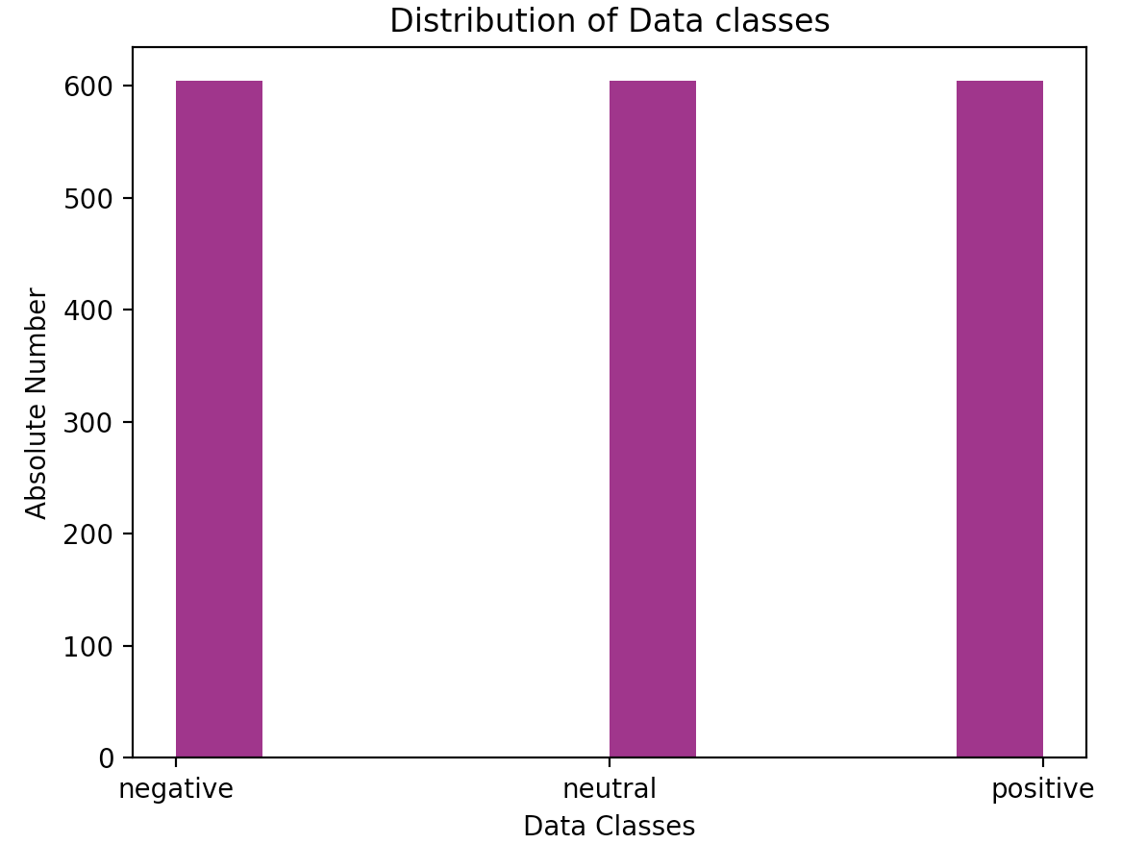
Data Research
III. Project Steps
Sentiment Data
FinPhrase Data Set
Categories
Positive: 604
Neutral: 604
Negative: 604
Total: 1812
Downsized

Slide 25
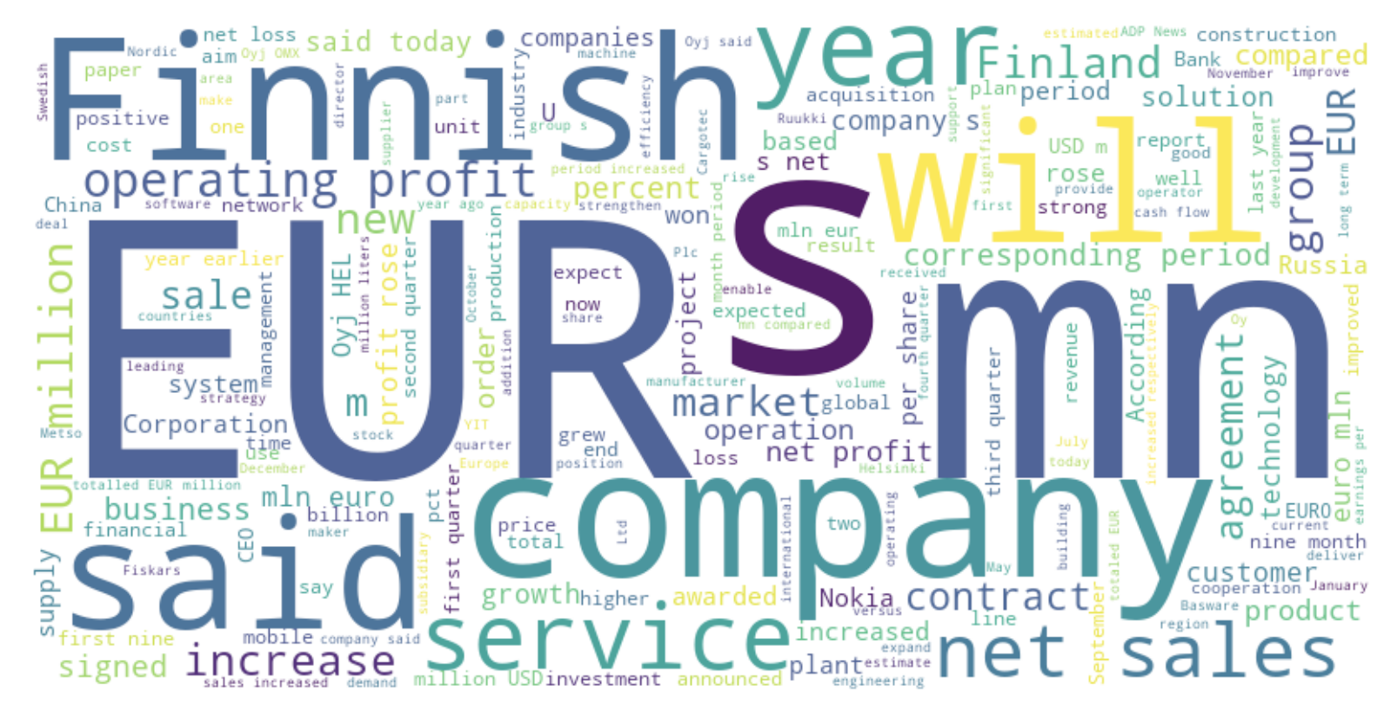
Data Research
III. Project Steps
Sentiment Data
Positive Sentiment

Slide 26
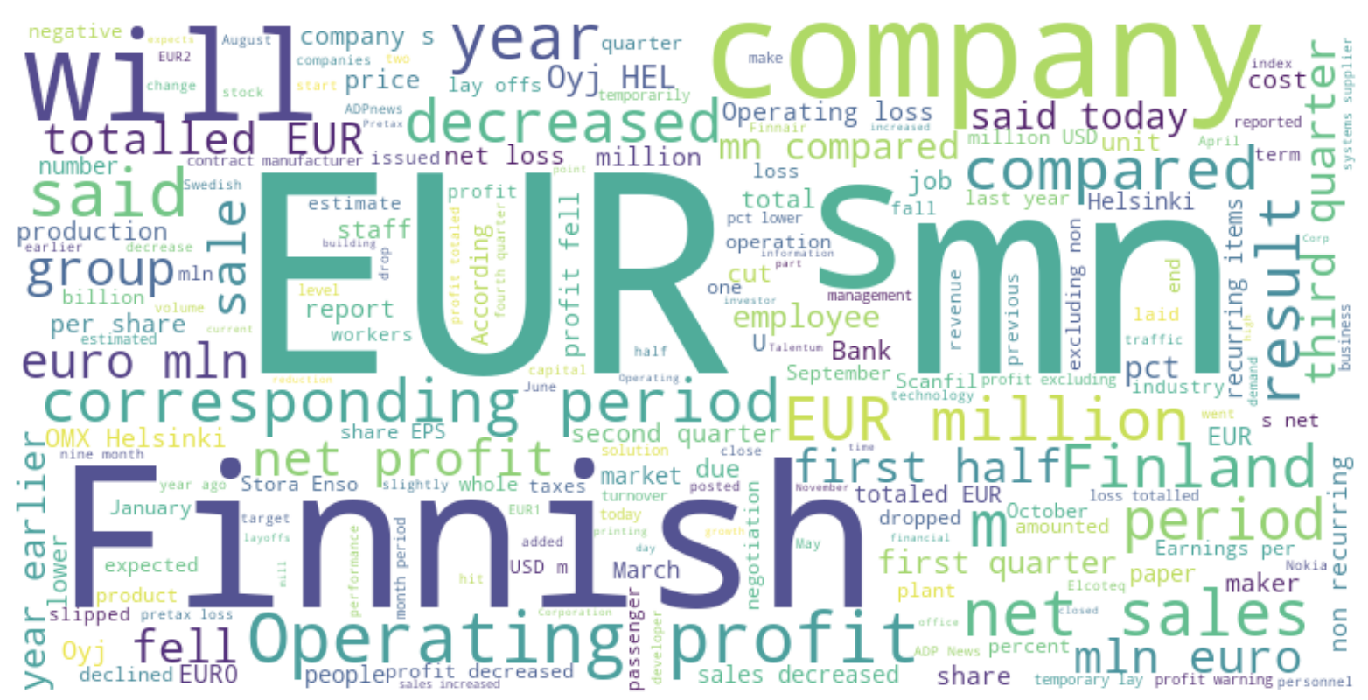
Data Research
III. Project Steps
Sentiment Data
Negative Sentiment

Slide 27
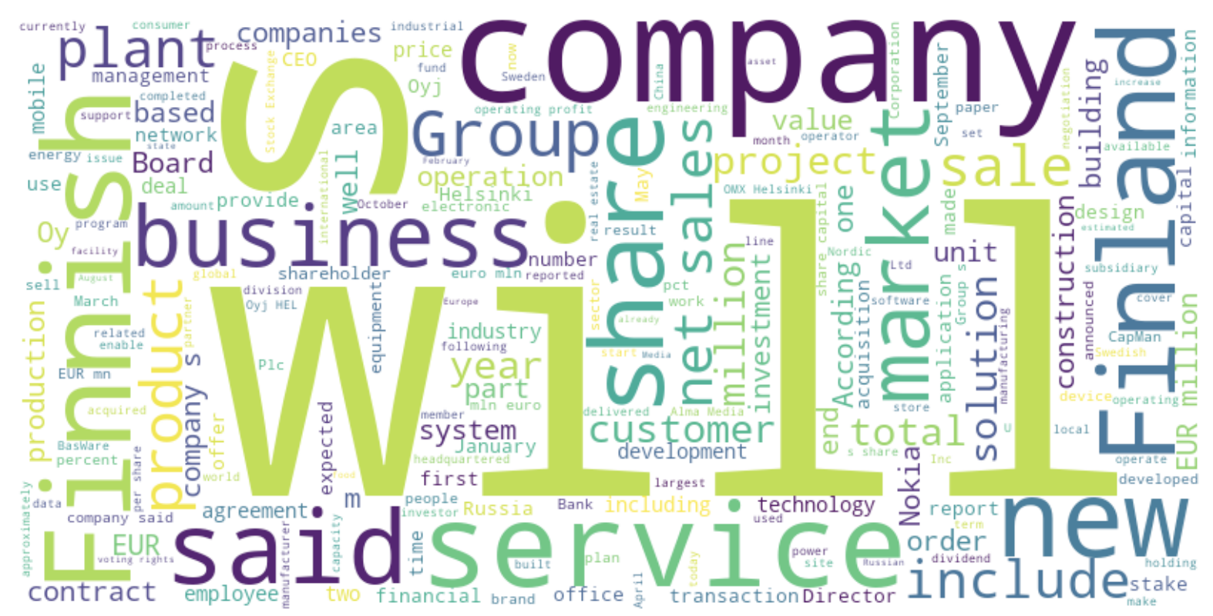
Data Research
III. Project Steps
Sentiment Data
Neutral Sentiment

Slide 28
III. Project Steps
Data Research
-
News Article Data
Bildquelle:
https://www.google.com/url?sa=i&url=https%3A%2F%2Fme2be.de%2Fhochschulen%2Fcau-christian-albrechts-universitaet-zu-kiel%2F&psig=AOvVaw3pyzL9cEIYeIjpIqHRPR5F&ust=1667135603618000&source=images&cd=vfe&ved=0CAoQjRxqFwoTCKDeyqLChfsCFQAAAAAdAAAAABAM

Slide 29

Data Research
III. Project Steps
News Data

Slide 30
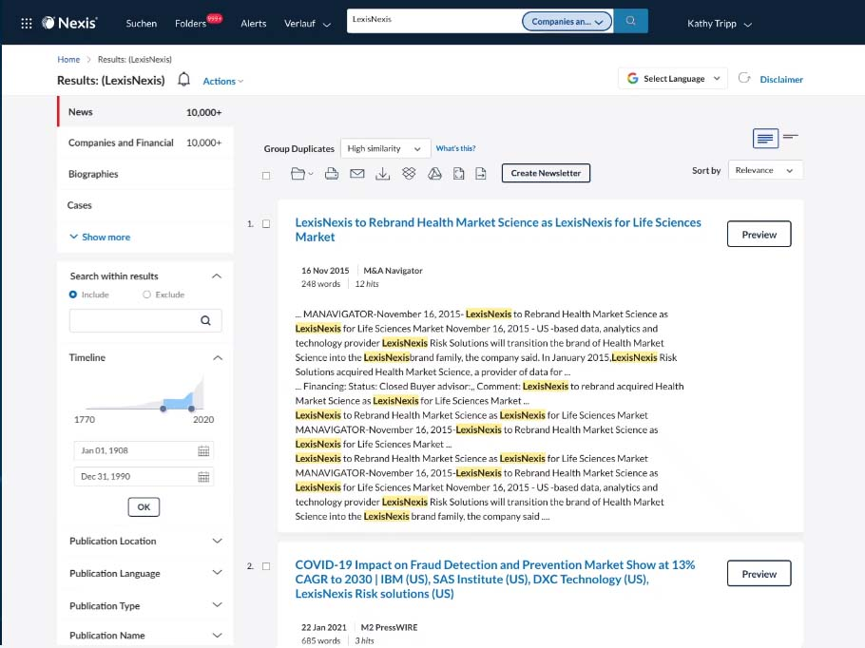
Data Research
III. Project Steps
News Data

Slide 31
III. Project Steps
Data Research
-
Short Volume Data
Bildquelle:
https://www.google.com/url?sa=i&url=https%3A%2F%2Fme2be.de%2Fhochschulen%2Fcau-christian-albrechts-universitaet-zu-kiel%2F&psig=AOvVaw3pyzL9cEIYeIjpIqHRPR5F&ust=1667135603618000&source=images&cd=vfe&ved=0CAoQjRxqFwoTCKDeyqLChfsCFQAAAAAdAAAAABAM

Slide 32
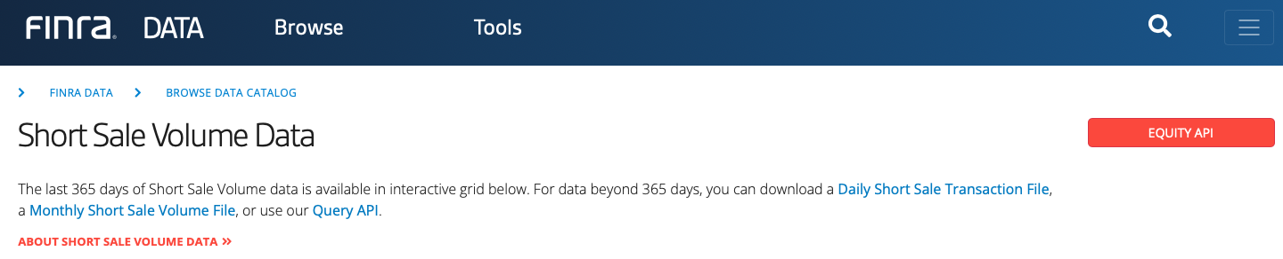
Data Research
III. Project Steps
Short Sale Data
FINRA Data Set

Slide 33
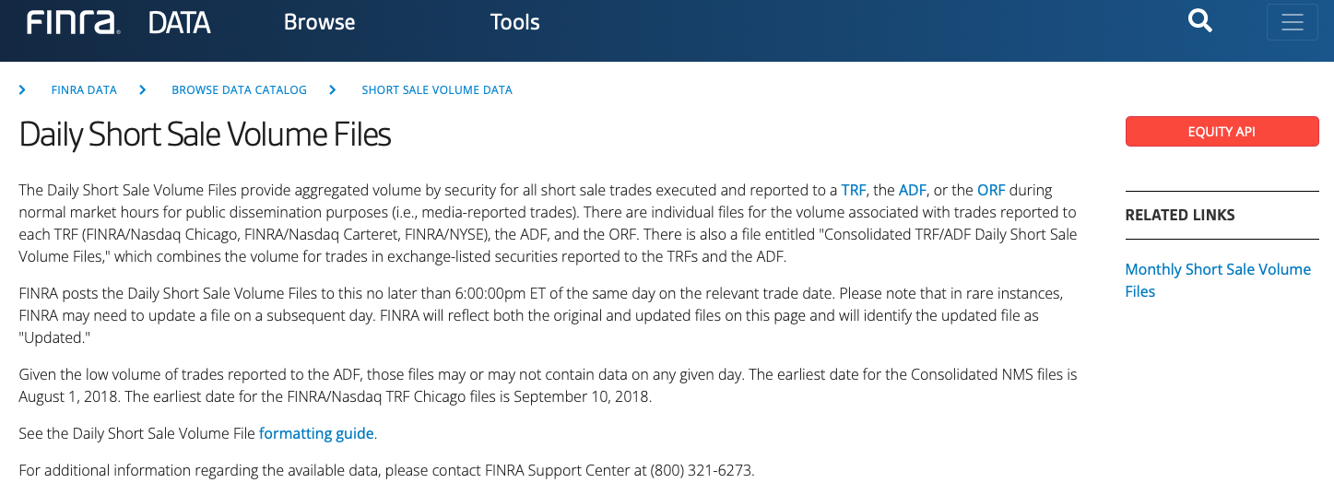
Data Research
III. Project Steps
Short Sale Data
FINRA Data Set

Slide 34
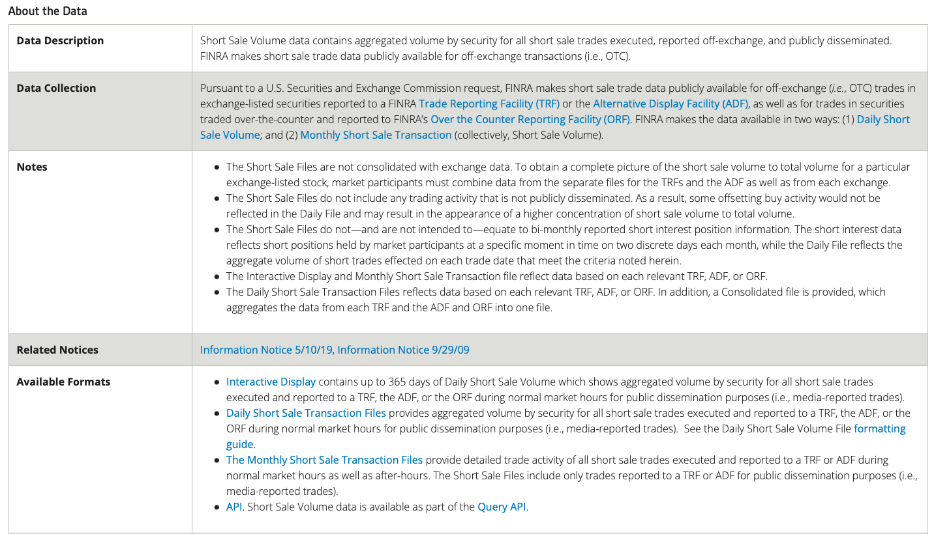
Data Research
III. Project Steps
Short Sale Data
FINRA Data Set

Slide 35
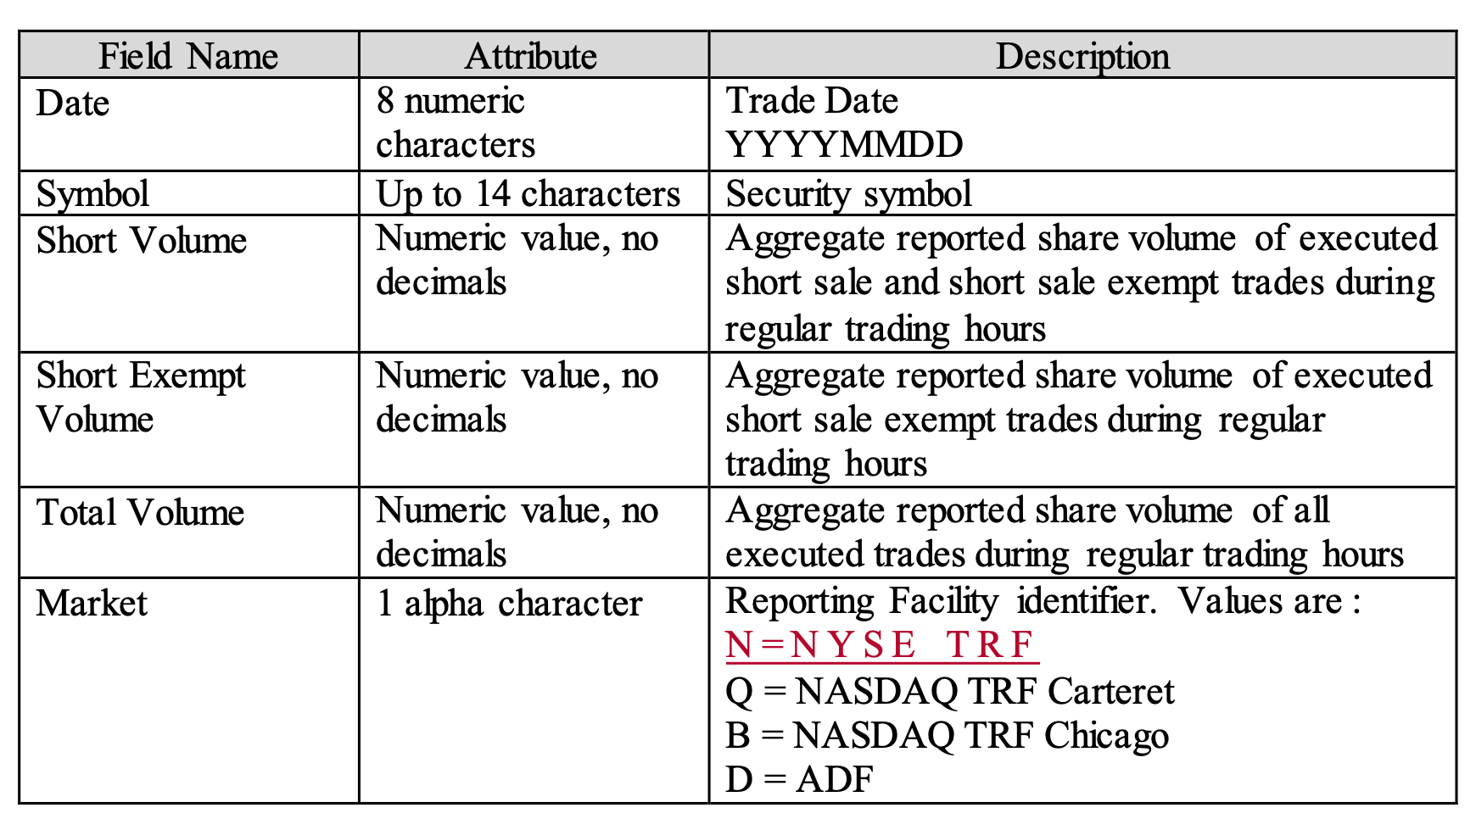
Data Research
III. Project Steps
Short Sale Data
FINRA Data Set
New Column

Slide 36
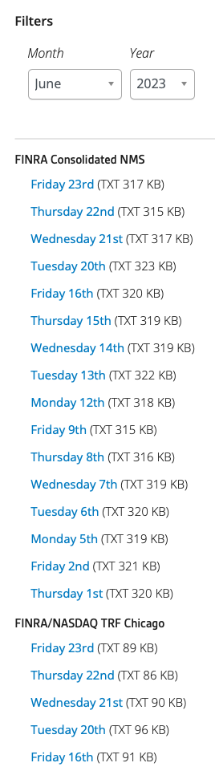
Data Research
Date range:
Jan 2010 – Jun 2023
III. Project Steps
Short Sale Data
12 Years, 6 Months:
(12 * 6) + 6 = 78 months
78 months * 21 days = 1638 single files for each reporting facility
FINRA Data Set
Reporting Market places:
Consolidated Numbers
NASDAQ TRF Chigaco
ADF
NASDAQ TRF Carteret
NYSE TRF
ORF

Slide 37
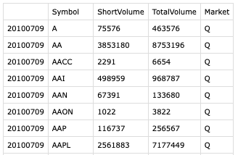
Data Research
III. Project Steps
Short Sale Data
Date (day)
Stock Ticker
Short Volume
Total Traded Volume on reporting Facility
FINRA Data Set

Slide 38
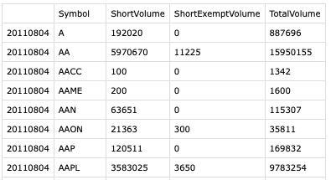
Data Research
III. Project Steps
Short Sale Data
Date (day)
Stock Ticker
Short Volume on reporting Facility
Total Traded Volume on reporting Facility
FINRA Data Set
New Column

Slide 39
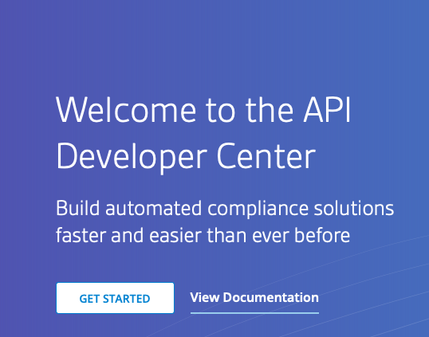
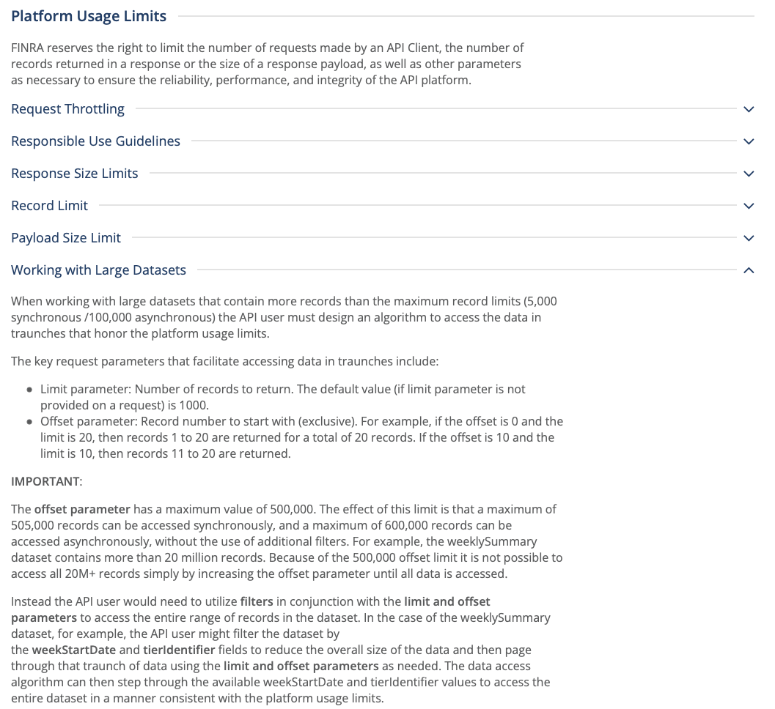
Data Research
III. Project Steps
Short Sale Data
FINRA Data Set

Slide 40
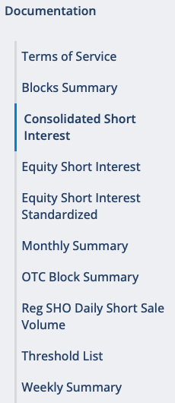
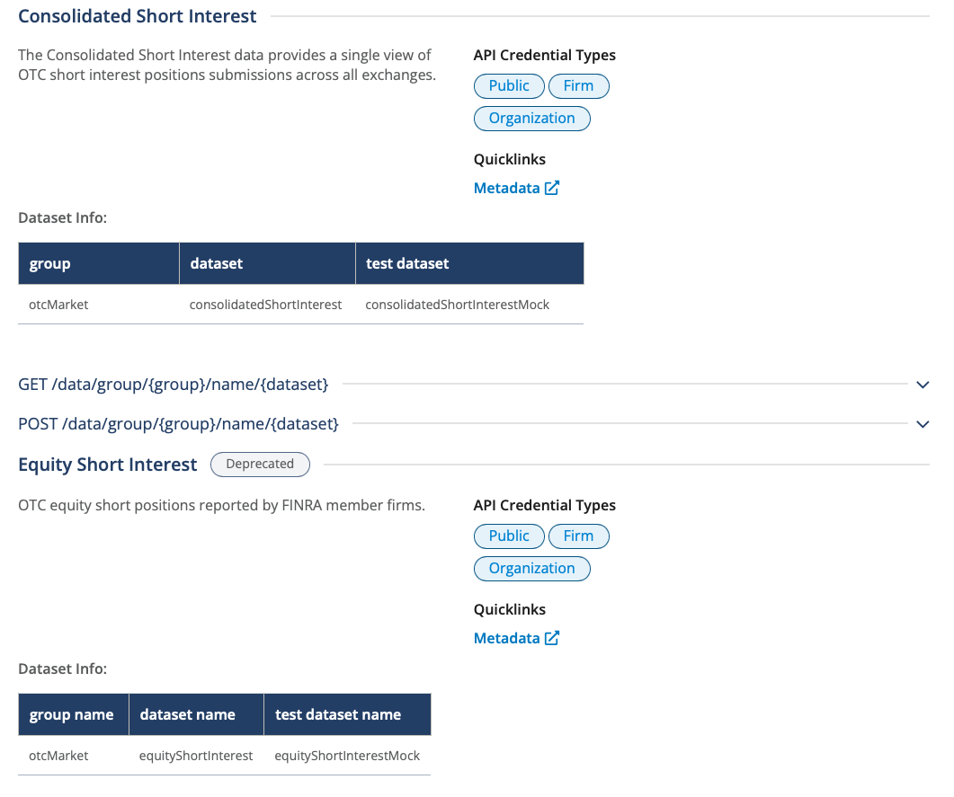
Data Research
III. Project Steps
Short Sale Data
FINRA Data Set

Slide 41
III. Project Steps
Data Aggregation
Bildquelle:
https://www.google.com/url?sa=i&url=https%3A%2F%2Fme2be.de%2Fhochschulen%2Fcau-christian-albrechts-universitaet-zu-kiel%2F&psig=AOvVaw3pyzL9cEIYeIjpIqHRPR5F&ust=1667135603618000&source=images&cd=vfe&ved=0CAoQjRxqFwoTCKDeyqLChfsCFQAAAAAdAAAAABAM

Slide 42
III. Project Steps
Data Research
Data Aggregation
Data Cleaning/Formatting
Data Selection
Model training
Model setup: NLP Classification
Data/Feature Engineering
Model optimization
Inference, Statistics and Robustness Tests

Slide 43

Data Aggregation
III. Project Steps
Short Sale Data

Slide 44
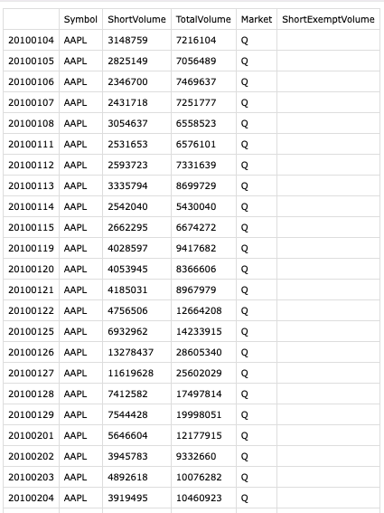

Data Aggregation
III. Project Steps
Short Sale Data

Slide 45
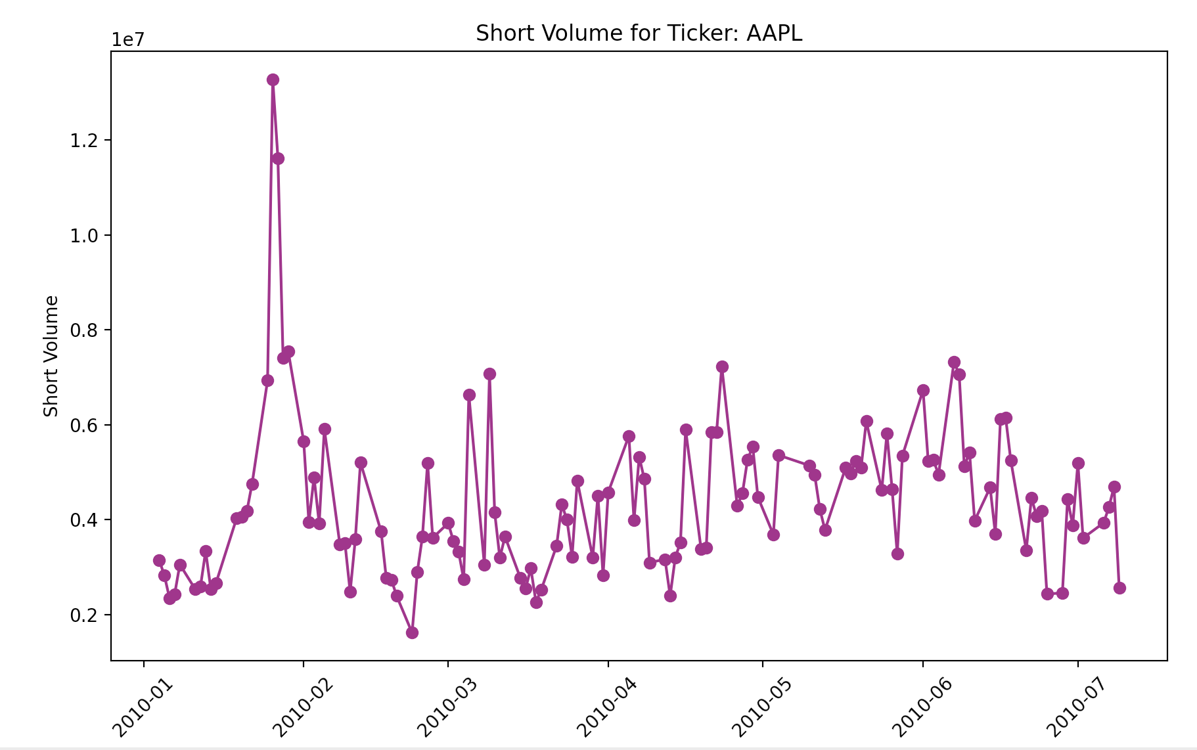
Data Aggregation
III. Project Steps
Short Sale Data
Absolute Values

Slide 46
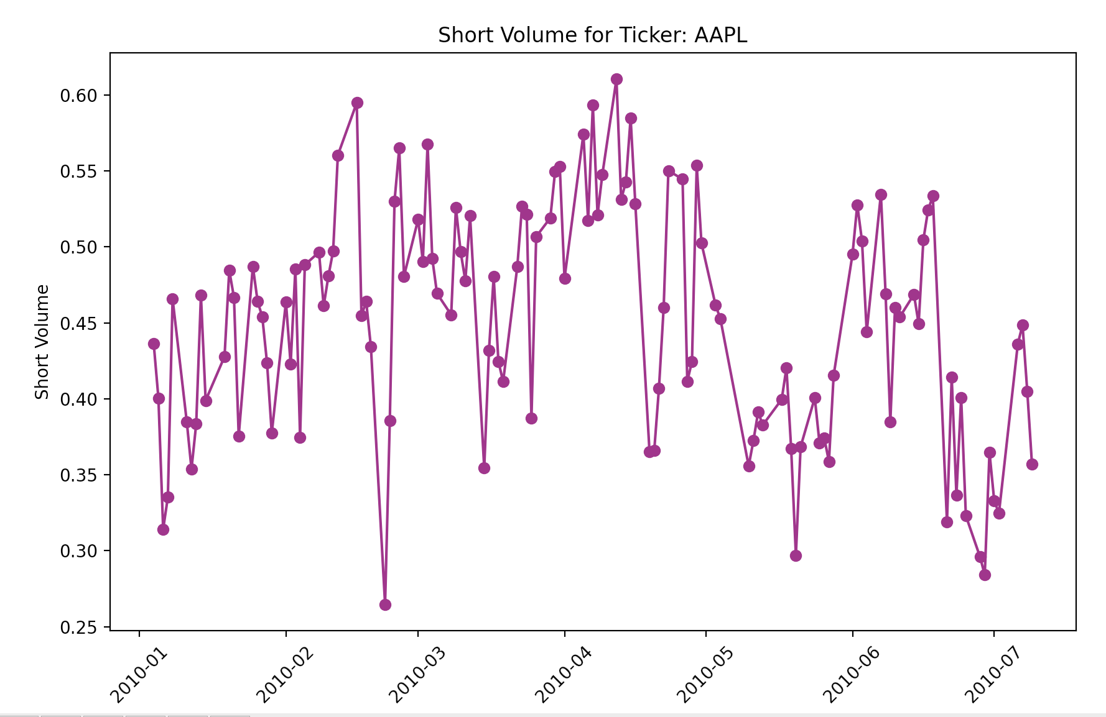
Data Aggregation
III. Project Steps
Short Sale Data
Relative Values compared to Total Volume from Reporting Facility

Slide 47
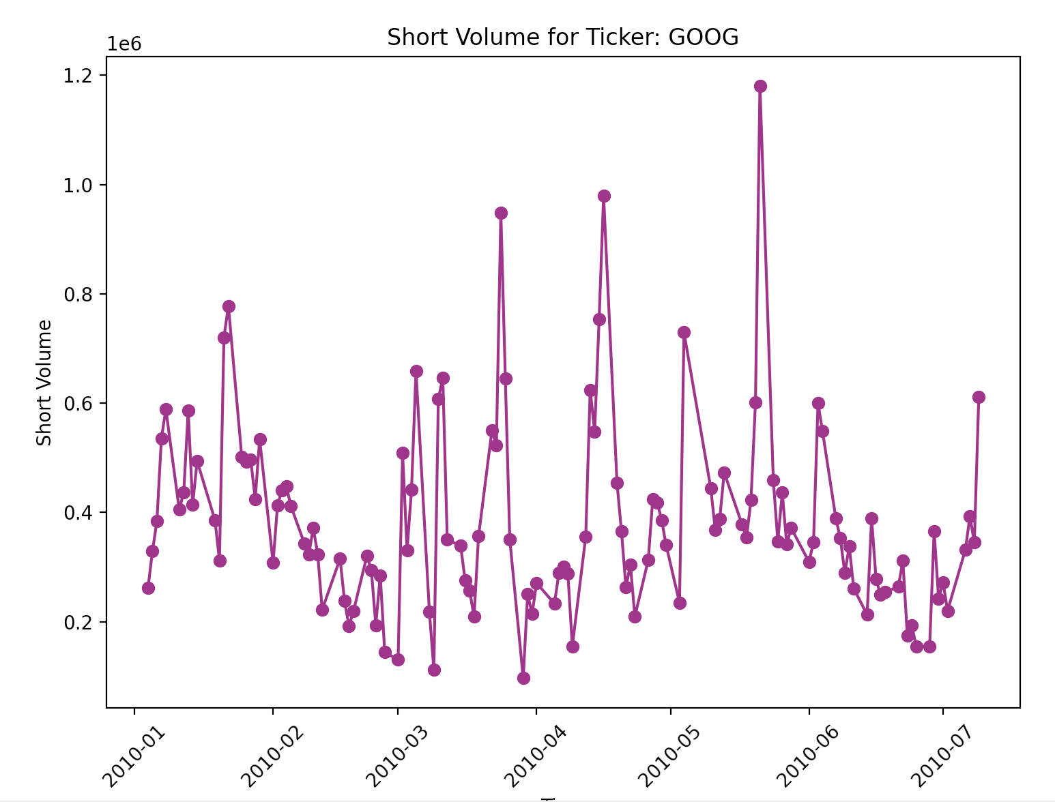
Data Aggregation
III. Project Steps
Short Sale Data
Absolute Values

Slide 48
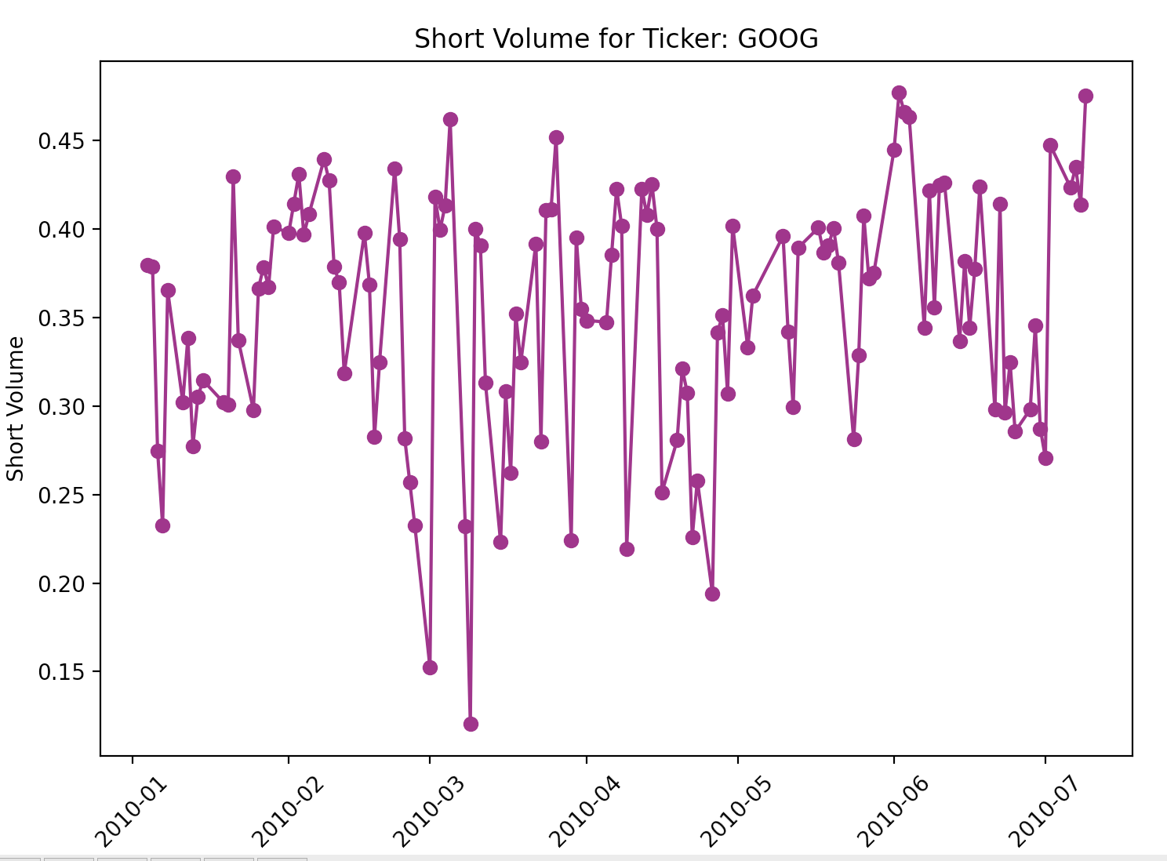
Data Aggregation
III. Project Steps
Short Sale Data
Relative Values compared to Total Volume from Reporting Facility

Slide 49
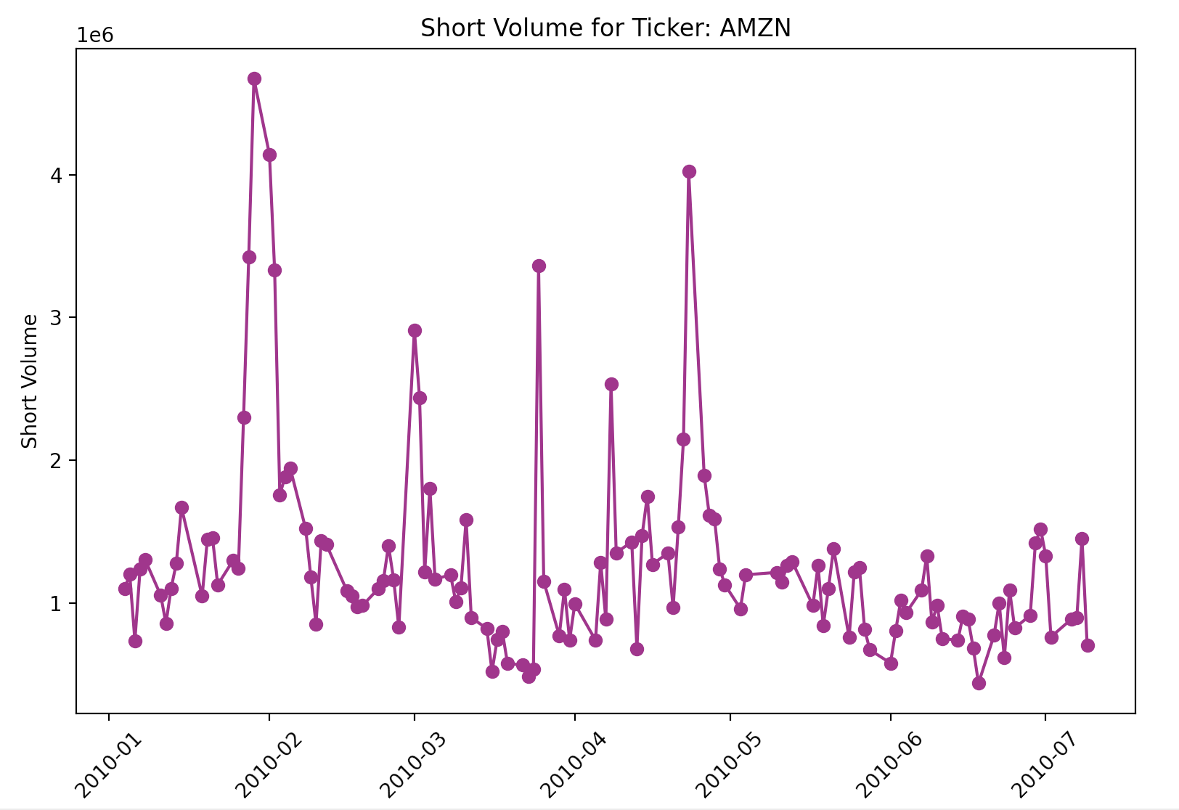
Data Aggregation
III. Project Steps
Short Sale Data
Absolute Values

Slide 50
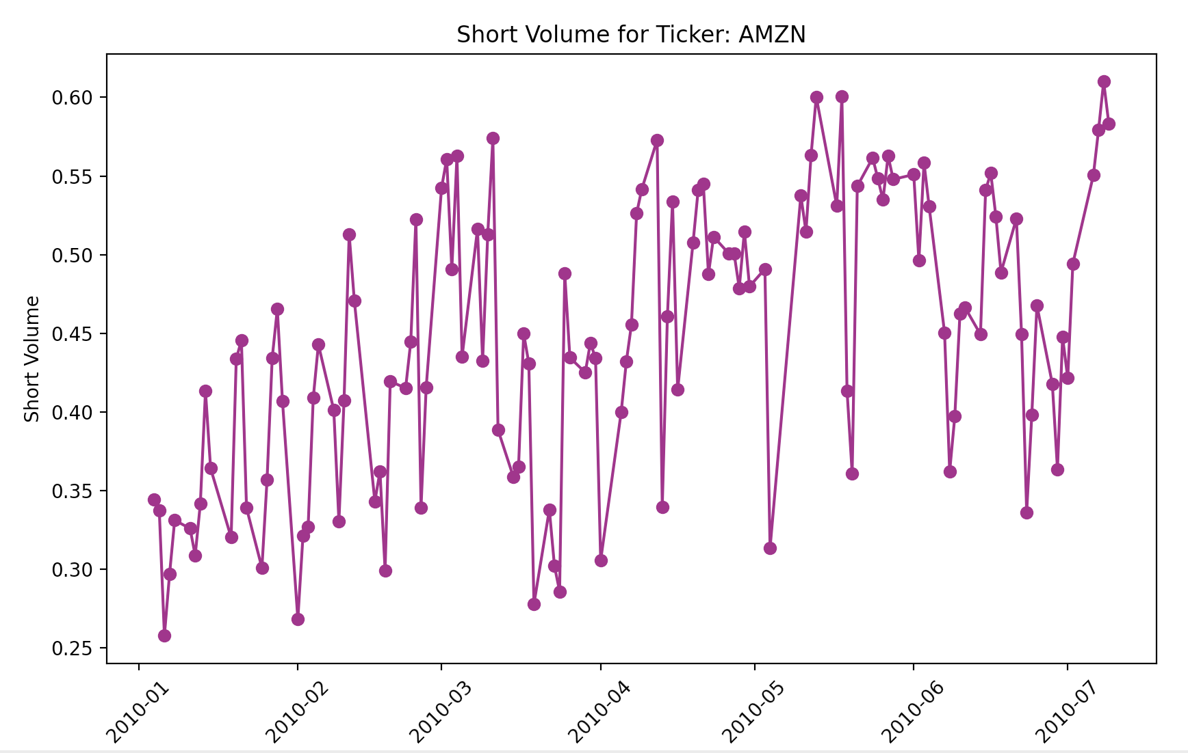
Data Aggregation
III. Project Steps
Short Sale Data
Relative Values compared to Total Volume from Reporting Facility

Slide 51
III. Project Steps
Model setup: NLP Classification
Bildquelle:
https://www.google.com/url?sa=i&url=https%3A%2F%2Fme2be.de%2Fhochschulen%2Fcau-christian-albrechts-universitaet-zu-kiel%2F&psig=AOvVaw3pyzL9cEIYeIjpIqHRPR5F&ust=1667135603618000&source=images&cd=vfe&ved=0CAoQjRxqFwoTCKDeyqLChfsCFQAAAAAdAAAAABAM

Slide 52
III. Project Steps
Data Research
Data Aggregation
Data Cleaning/Formatting
Data Selection
Model training
Model setup: NLP Classification
Data/Feature Engineering
Model optimization
Inference, Statistics and Robustness Tests

Slide 53
Model setup
III. Project Steps
NLP Classification
Develop the whole model on our own
Use a pretrained model and optimize it
Need of labeled dataset
No need of labeled dataset
Categorical labels (good, neutral, bad)
Numerical labels (good: 70-100, neutral: 40-60, bad: 0-40)
Tweak Model output to satisfy the needed numerical scale
Fin Phrase Dataset
Pretrained FinBert Model

Slide 54
Model setup
III. Project Steps
Pretrained FinBert Model
FinBERT

Slide 55
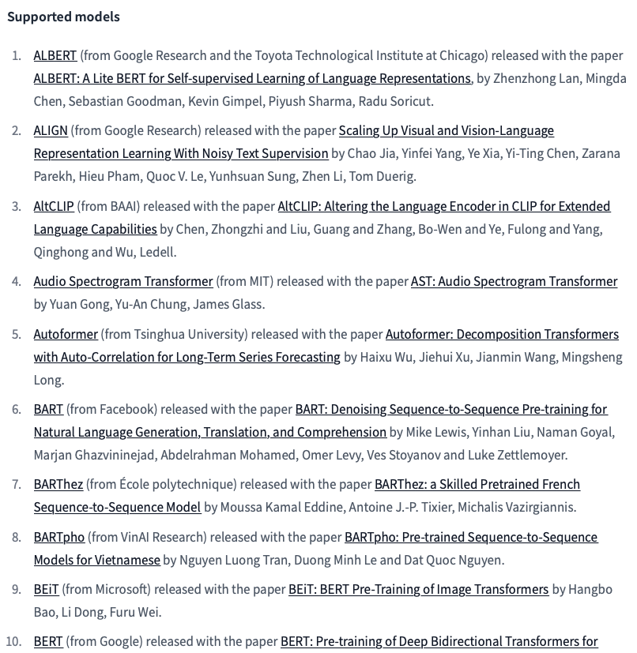
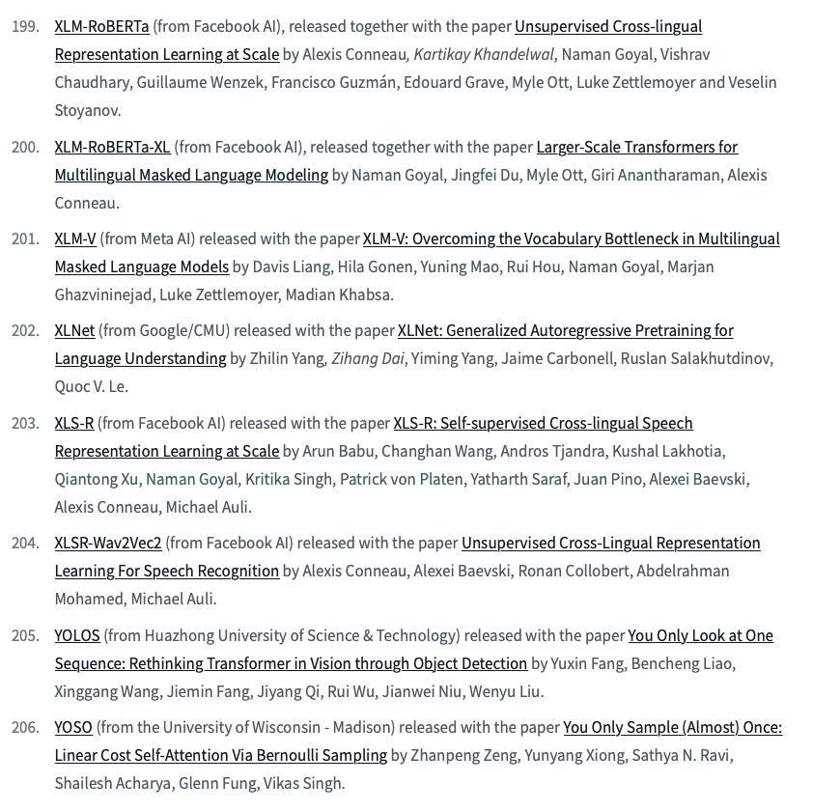
Model setup
III. Project Steps
Models

Slide 56
Model setup
III. Project Steps
Trained Models
Default Model
Self-trained on Fin Phrase Dataset
Tuned FinBert Model
Tuned BertBaseUnCased Model
Hugging Face Pipeline: distilbert-base-uncased-finetuned-sst-2-english
Hugging Face:
ProsusAI/finbert
Hugging Face:
bert-base-uncased
nlp_sentiment_model_pretrained_2.py
nlp_sentiment_model.py
nlp_sentiment_model_FinBert.py
nlp_sentiment_model_pretrained_1.py

Slide 57
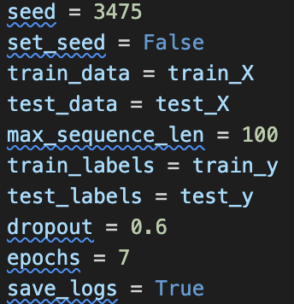
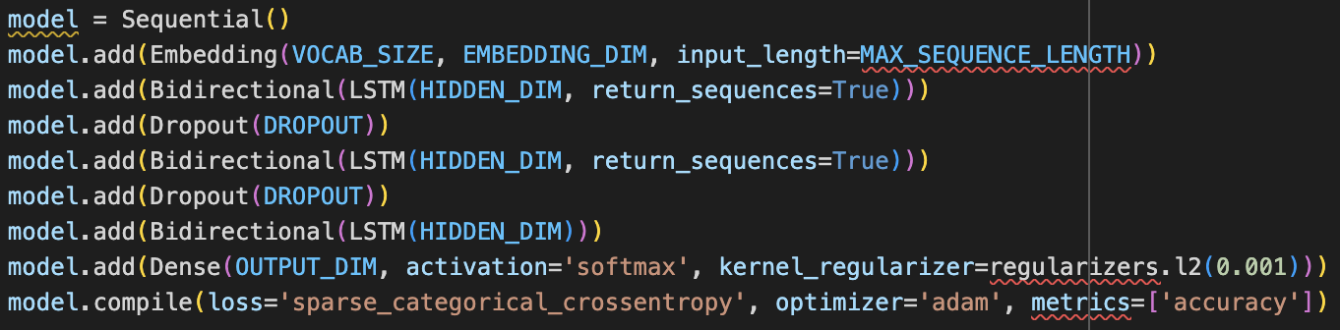
Model setup
III. Project Steps
Self-trained on Fin Phrase Dataset

Slide 58
III. Project Steps
Model training
Bildquelle:
https://www.google.com/url?sa=i&url=https%3A%2F%2Fme2be.de%2Fhochschulen%2Fcau-christian-albrechts-universitaet-zu-kiel%2F&psig=AOvVaw3pyzL9cEIYeIjpIqHRPR5F&ust=1667135603618000&source=images&cd=vfe&ved=0CAoQjRxqFwoTCKDeyqLChfsCFQAAAAAdAAAAABAM

Slide 59
III. Project Steps
Data Research
Data Aggregation
Data Cleaning/Formatting
Data Selection
Model training
Model setup: NLP Classification
Data/Feature Engineering
Model optimization
Inference, Statistics and Robustness Tests

Slide 60
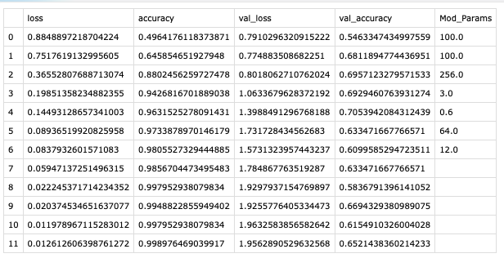

Model training
III. Project Steps
Self-trained on Fin Phrase Dataset

Slide 61
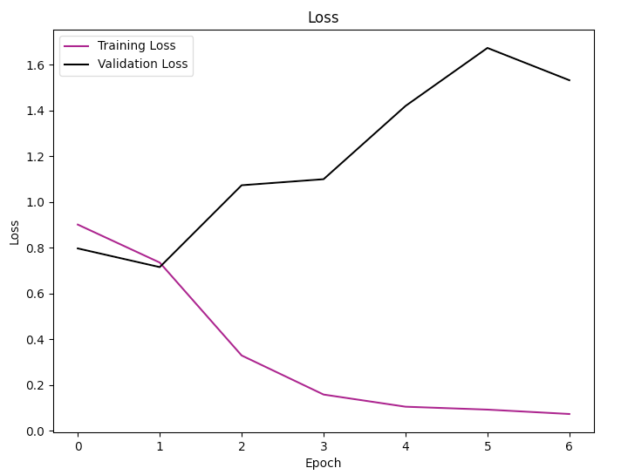
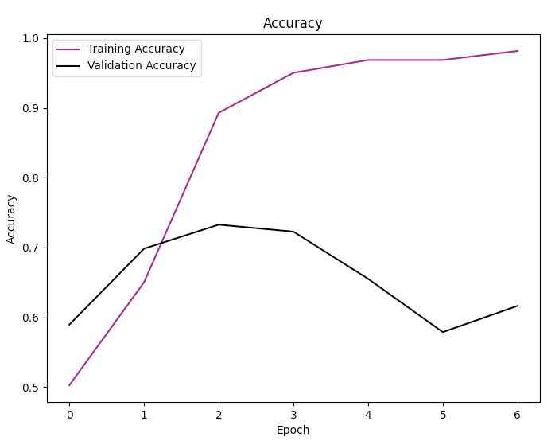
Model training
III. Project Steps
Self-trained on Fin Phrase Dataset
Hidden Dim: 256 Dropout: 0.6 Batch Size: 64. Epochs: 7

Slide 62
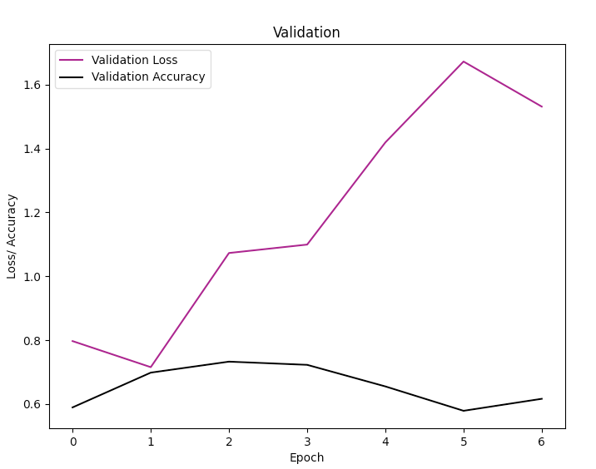
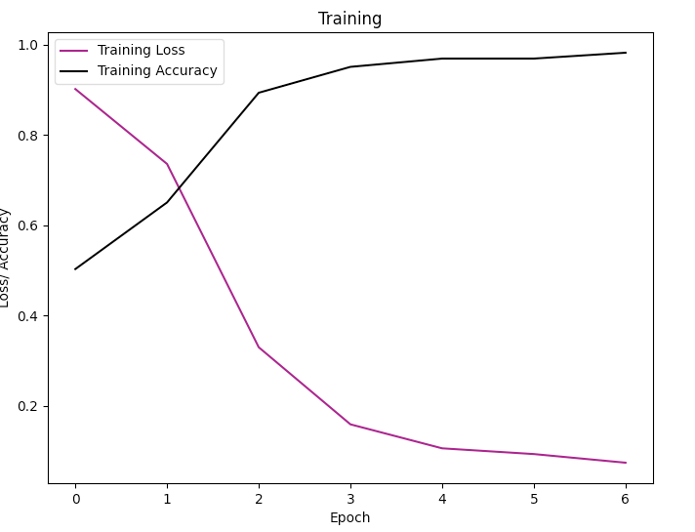
Model training
III. Project Steps
Self-trained on Fin Phrase Dataset
Hidden Dim: 256 Dropout: 0.2 Batch Size: 64. Epochs: 7

Slide 63
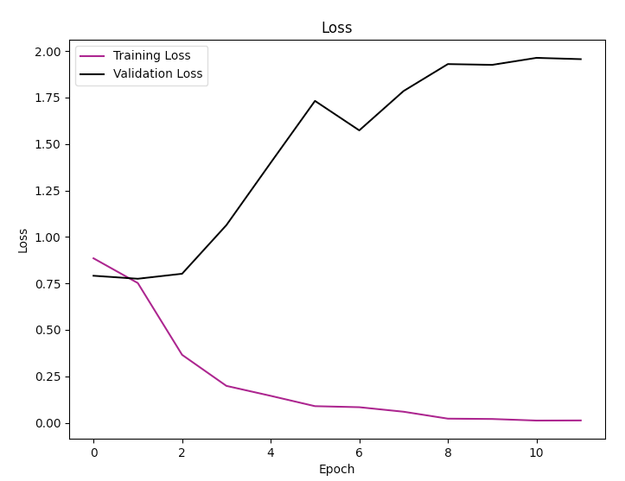
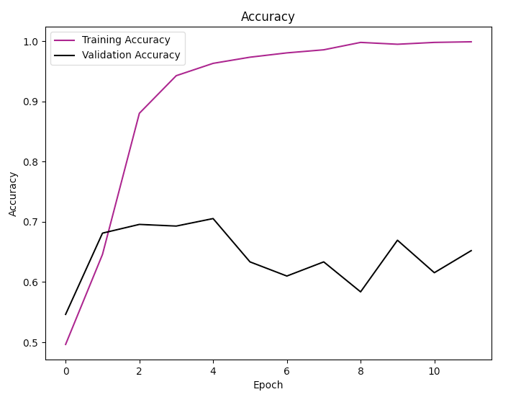
Model training
III. Project Steps
Self-trained on Fin Phrase Dataset
Hidden Dim: 256 Dropout: 0.6 Batch Size: 64. Epochs: 12

Slide 64
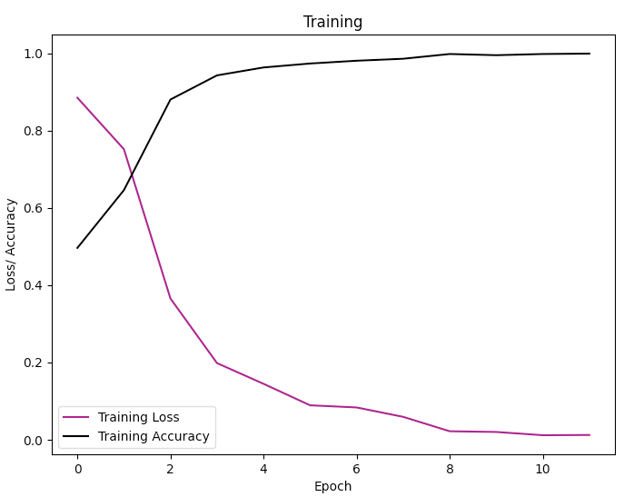
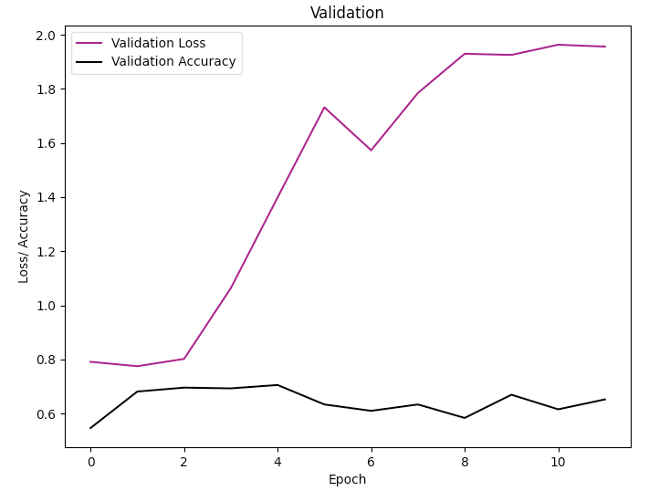
Model training
III. Project Steps
Self-trained on Fin Phrase Dataset
Hidden Dim: 256 Dropout: 0.6 Batch Size: 64. Epochs: 12

Slide 65
IV. Project Scope
To Dos
Bildquelle:
https://www.google.com/url?sa=i&url=https%3A%2F%2Fme2be.de%2Fhochschulen%2Fcau-christian-albrechts-universitaet-zu-kiel%2F&psig=AOvVaw3pyzL9cEIYeIjpIqHRPR5F&ust=1667135603618000&source=images&cd=vfe&ved=0CAoQjRxqFwoTCKDeyqLChfsCFQAAAAAdAAAAABAM

Slide 66
IV. Project Scope
Main Tasks:
Find granular data on short interest (for the German/US stock market)
Find appropriate news sources covering the respective companies (RSS Feeds, Google News)
-> LexisNexis
Create a news sentiment score (compare different available vocabularies, classification) from the categorical encoding of the models
Classify the articles as a whole
Evaluate Score from model over time – Compare different architectures
Tweak and optimize the model
Draw inferences and conduct statistical robustness tests

Slide 67
IV. Project Scope
Potential Problems:
Data availability – long enough continously ongoing time series on short interest
Media article – company matching
NLP Classification: Variations and Vocabularies, extensiveness of classification

Slide 68
V. Project Structure
Bildquelle:
https://www.google.com/url?sa=i&url=https%3A%2F%2Fme2be.de%2Fhochschulen%2Fcau-christian-albrechts-universitaet-zu-kiel%2F&psig=AOvVaw3pyzL9cEIYeIjpIqHRPR5F&ust=1667135603618000&source=images&cd=vfe&ved=0CAoQjRxqFwoTCKDeyqLChfsCFQAAAAAdAAAAABAM

Slide 69
V. Project Structure
/Project Folder/
exceptions.py
/Data/
/NLP_Model/
requirements.txt
get_data_short.py
nlp_sentiment_model.py
common_utils.py
get_data_news_articles.py
nlp_sentiment_model_pretrained_1.py
retrieve_data.py
nlp_sentiment_model_pretrained_1.py
secrets.yml
nlp_sentiment_model_FinBert.py
ReadMe.md
data_base.py
comp_classifier.py
/Summary/
/Raw_Data/
/Version_Control/
/GermanMarket/
Weights_ModelName
SentimentAnalysisOutline.pptx
/USMarket/
SentimentAnalysisFinal.pptx
/Text_Classification/
/Logs/
/Sentiment Index/
/News_Articles pdf/
sentiment_index.csv
/Log1_06062023_ModelName/
article_1.pdf
Mod_27-06-2023_13/41/25
article_2.pdf
/Literature/
/Short_Volume/
paper_1.pdf
01012020.csv
paper_2.pdf

Slide 70
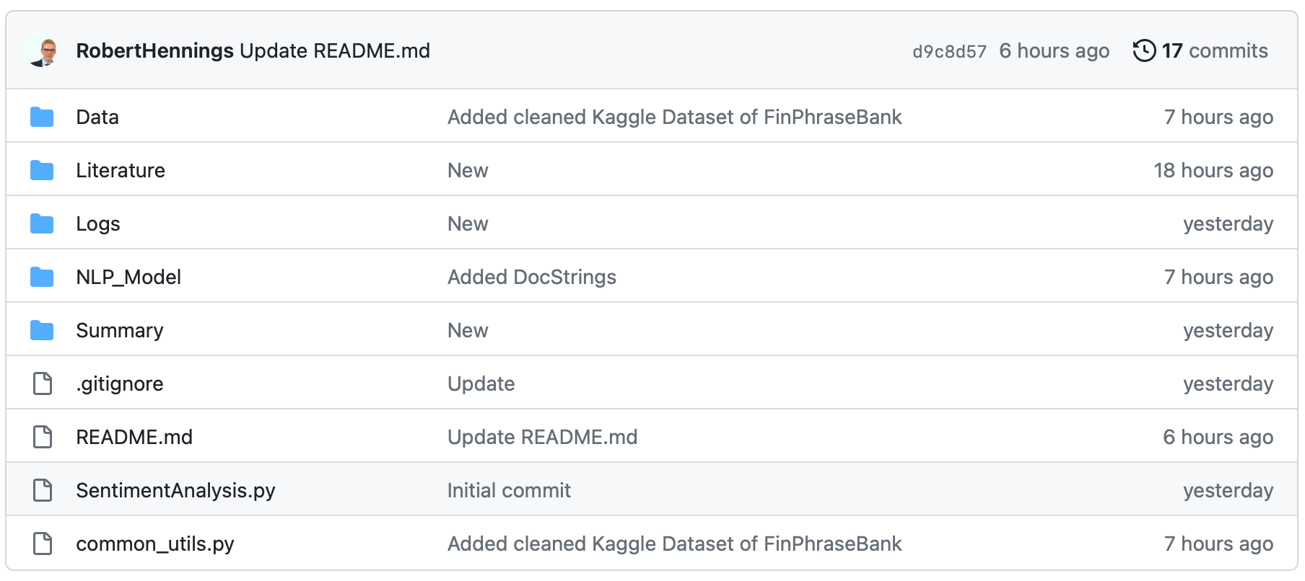
V. Project Structure
https://github.com/RobertHennings/OpenCampus_Sentiment_Project/tree/main

